Slide 1

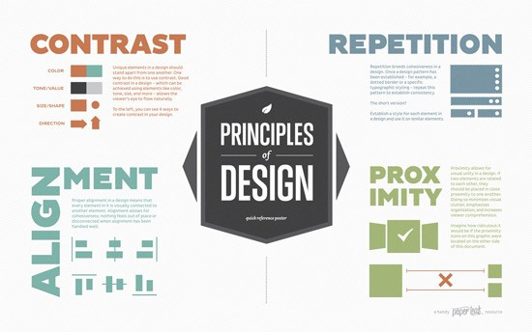
Graphic Design
Principles

Slide 2

Graphic Design Principles
Introduction
The principles of design suggest how a designer can best arrange the various components of a page layout to connect to the overall design and to one another.
All the principles of design, also known as principles of composition, apply to any piece you create. How you apply those principles determines how effective your design is in conveying the desired message and how attractive it appears. There is seldom only one correct way to apply each principle but check your document to see how well you applied each of these six principles of design.

Slide 3
Graphic Design Principles
Content
Balance
Proximity
White Space
Alignment
Repetition (Consistency)
Contrast (Emphasis)
Hierarchy

Slide 4
Graphic Design Principles
Balance
Just as in the physical world, visual balance is a good thing. It’s desirable in and of itself. An unbalanced composition can feel uncomfortable for the viewer.
Visual weight is a measure of the visual interest of an element or area in a design. When a composition is visually balanced, every part of it holds some interest. The visual interest is balanced, which keeps viewers engaged with the design.

Slide 5
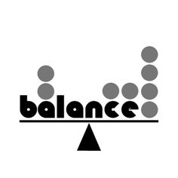
Graphic Design Principles
Balance
Without visual balance, viewers might not see all areas of the design. They probably won’t spend any time in areas with less visual weight or interest. Any information in those areas could easily go unnoticed.
You would balance a design visually because you want to balance the points of interest in your composition, so that viewers spend time with all of the information you want to convey.

Slide 6
Graphic Design Principles
Balance – Four Types of Balance
There’s more than one way to balance a composition.
Symmetrical
Asymmetrical
Radial
Mosaic

Slide 7
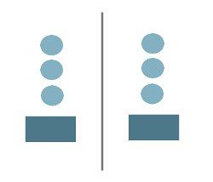
Graphic Design Principles
Balance – Symmetrical
Symmetrical balance occurs when equal weights are on equal sides of a composition, balanced around a fulcrum or axis in the centre. Symmetrical balance evokes feelings of formality (it’s sometimes called formal balance) and elegance. A wedding invitation is a good example of a composition that you’d likely want to be symmetrically balanced.
The downside of symmetrical balance is that it’s static and sometimes regarded as boring. Because half of the composition mirrors the other half, at least half of the composition will be rather predictable.

Slide 8
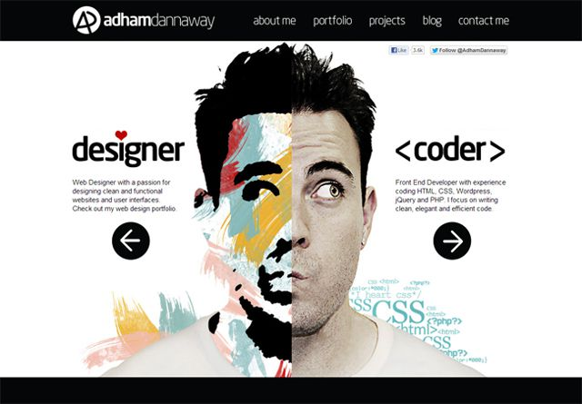
Graphic Design Principles
Balance – Symmetrical

Slide 9
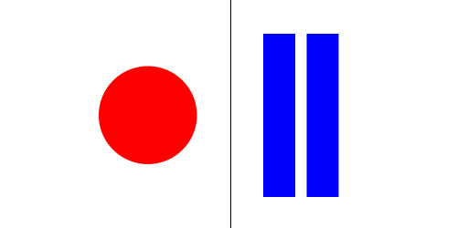
Graphic Design Principles
Balance – Asymmetrical
Asymmetrical balance results from unequal visual weight on each side of the composition. One side of the composition might contain a dominant element, which could be balanced by a couple or more lesser focal points on the other side. One visually heavy element on one side might be balanced by a handful of lighter elements on the other.
Asymmetrical balance is more dynamic and interesting. It evokes feelings of modernism, movement, energy and vitality. Asymmetrical balance offers more visual variety, although it can be more difficult to achieve because the relationships between elements are more complex.

Slide 10
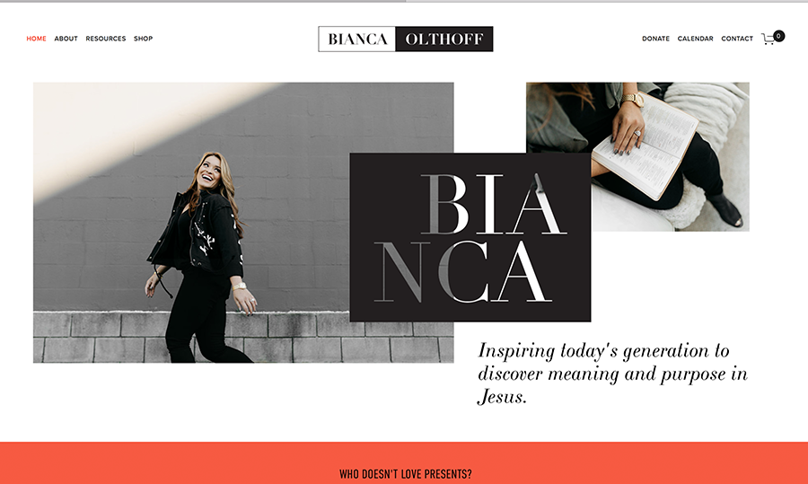
Graphic Design Principles
Balance – Asymmetrical

Slide 11
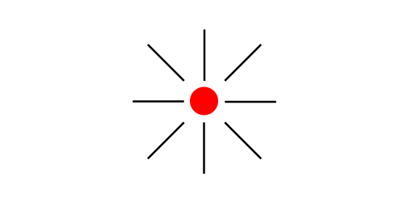
Graphic Design Principles
Balance – Radial
Radial balance occurs when elements radiate from a common centre. Rays of sunlight and ripples in a pond after a stone is tossed in are examples of radial balance. Maintaining a focal point (fulcrum) is easy because it’s always the centre.
Because everything radiates from a common centre, everything also leads to that centre, making it a strong point of attraction.

Slide 12
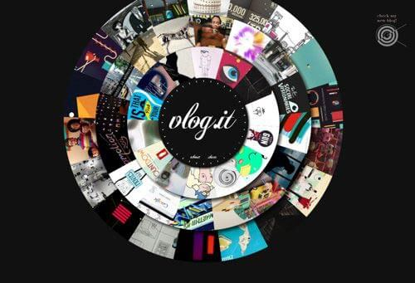
Graphic Design Principles
Balance – Radial

Slide 13
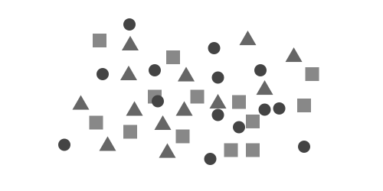
Graphic Design Principles
Balance – Mosaic
Mosaic balance (or crystallographic balance) results from balanced chaos. Think Jackson Pollack paintings. The composition lacks distinct focal points, and the elements share a uniform emphasis. The lack of hierarchy leads to visual noise at first glance. Somehow, though, it all works together.

Slide 14
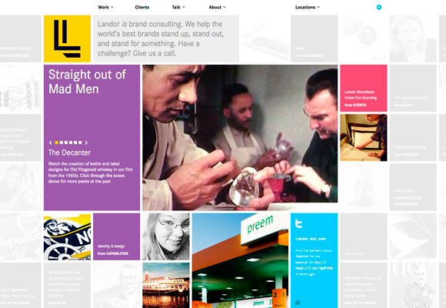
Graphic Design Principles
Balance – Mosaic

Slide 15
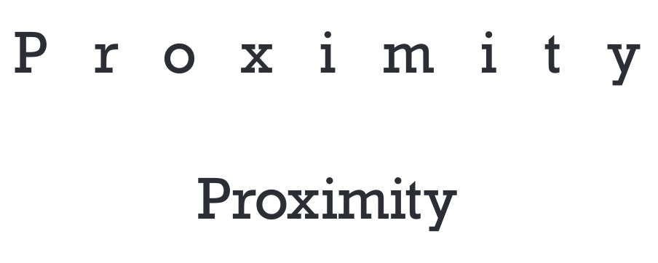
Graphic Design Principles
Proximity
The principle of proximity calls for related items to be grouped visually, creating less clutter and making for a more organised layout. Items unrelated to each other should be placed further apart, to emphasise their lack of relationship.
The correct use of proximity, in conjunction with other design principles, has a big impact on the user experience and, ultimately, a website’s overall success.

Slide 16
Graphic Design Principles
Proximity
The basic premise and the rules governing this principle are pretty straightforward.
Things that are related should be close together.
Things that are unrelated should be further apart.

Slide 17
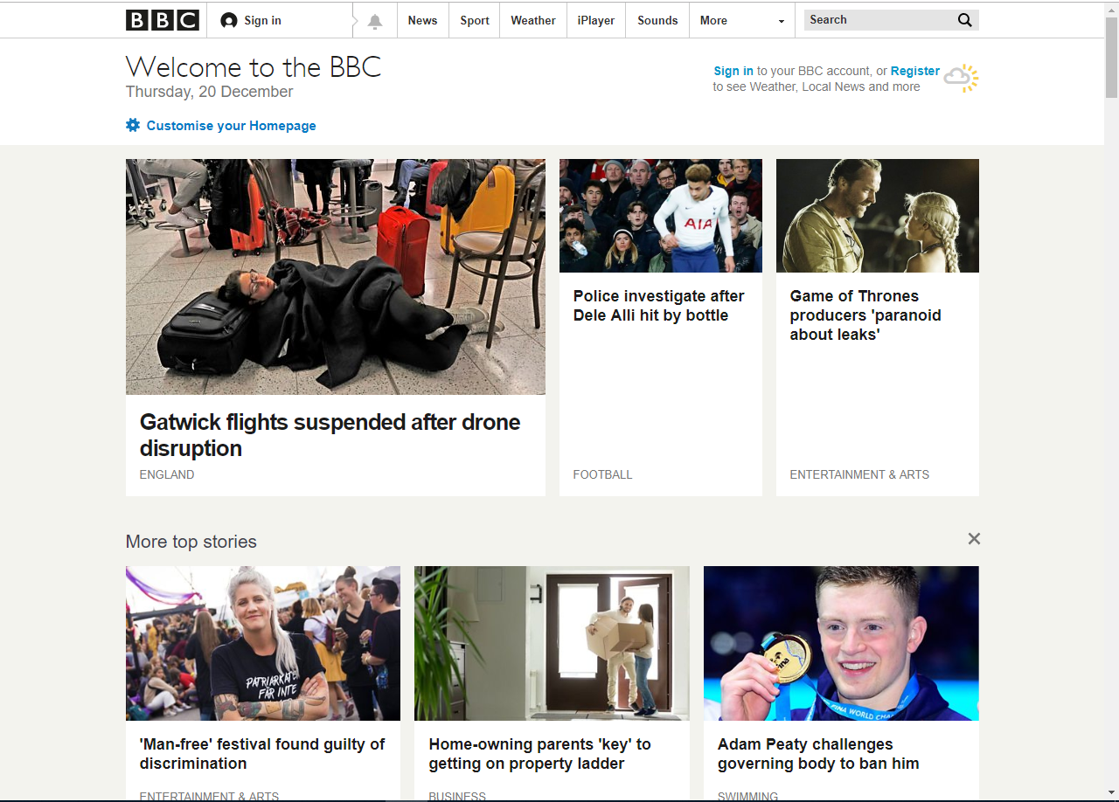
Graphic Design Principles
Proximity

Slide 18
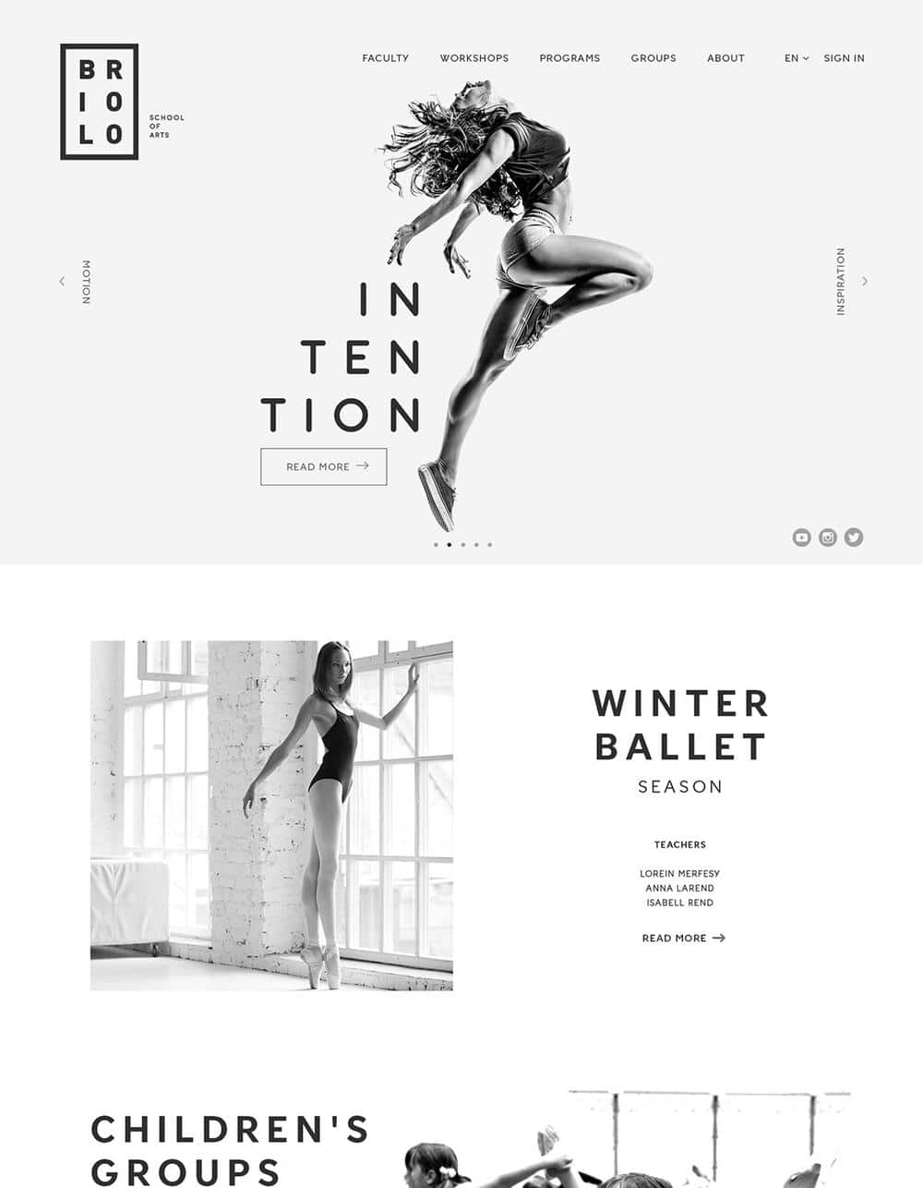
Graphic Design Principles
White Space
White Space is the part of a design that is left blank. Negative space is empty space that is intentionally placed in the design. The margins and gutters between other elements are referred to as passive space.
Space in a design adds emphasis to an area because the eye is strongly drawn to the part of the design that is not empty. Both positive and negative space should be considered in graphic design.

Slide 19
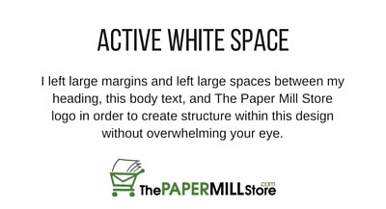
Graphic Design Principles
White Space – Active vs Passive
Active white space is negative space you’ve made a conscious effort to include in order to create emphasis or structure within your design. Active white space can draw your reader’s eye to a certain focal point, and it helps create flow within your design.

Slide 20
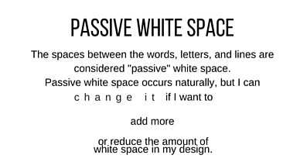
Graphic Design Principles
White Space – Active vs Passive
Passive white space occurs naturally. Kerning and leading are both examples of passive white space, and you can manually alter both to add or reduce white space.

Slide 21
Graphic Design Principles
Alignment
Alignment refers to placing text and other design elements on a page so they line up. It helps to create order, organise your elements, create visual connections, and improve the readability of your design. There are several types of alignment, and the type you use will ultimately depend on your design.
Horizontal
Vertical
Edge
Centre
Visual/Optical
Breaking

Slide 22
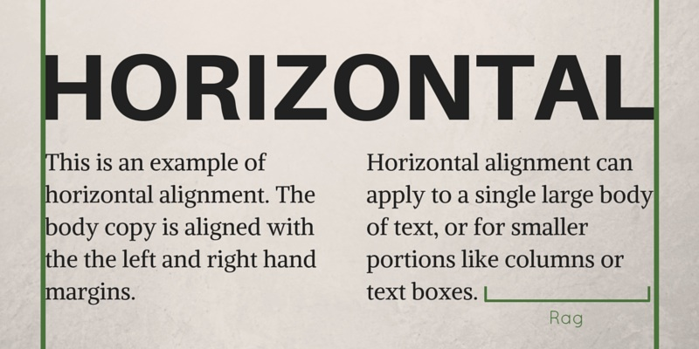
Graphic Design Principles
Alignment - Horizontal
If something is horizontally aligned, that means that either the left or right (or both!) margins are equal. Horizontal alignment can apply across an entire page or in columns.
Horizontally aligned items can be flush with the left or right margins. Just remember to keep an eye on “rag” (the white space left at the end of a left justified line of text) – too much rag can create a sense of visual misalignment and hinder the readability and visual appeal of your design.

Slide 23
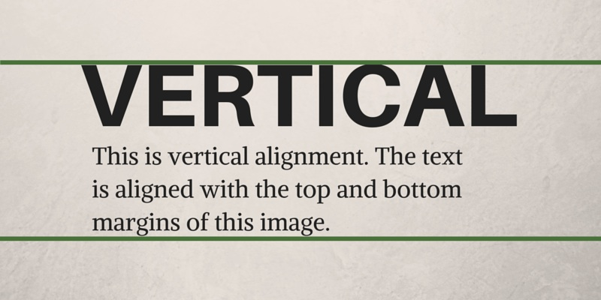
Graphic Design Principles
Alignment - Vertical
In vertical alignment, your text or other design elements are lined up with the top and/or bottom margins of the page. Like horizontal alignment, vertical alignment can apply to the whole page or portions of it.

Slide 24
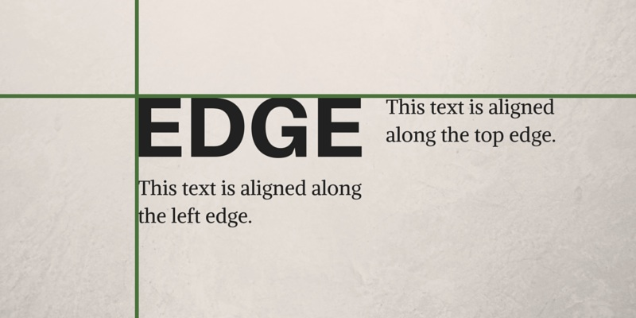
Graphic Design Principles
Alignment - Edge
Edge alignment occurs when your text and design elements are lined up with each other’s top, bottom, or side edges. Unlike horizontal or vertical alignment, edge alignment isn’t affected by the page margin.

Slide 25
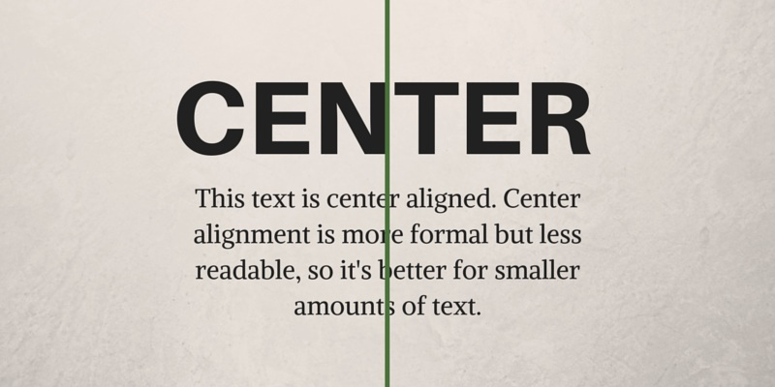
Graphic Design Principles
Alignment - Centre
Centre alignment is exactly what it sounds like – your elements are aligned along a central axis. Centre alignment is a little more formal, which is why you often see it on things like wedding invitations. Centre alignment isn’t ideal for large bodies of text because it’s also less readable; each line of text starts in a different place, so your eye doesn’t follow the words as easily or naturally.

Slide 26
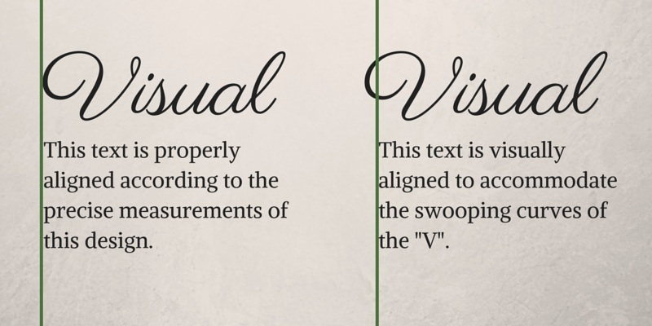
Graphic Design Principles
Alignment – Visual/Optical
Sometimes, an element can be properly aligned based on measurements, but it appears misaligned because of the design of the specific element. This is particularly common with rounded elements like circular shapes or large, curly letters.
Visual or optical alignment occurs when something looks properly aligned, but may not necessarily be properly aligned according to the precise measurements of your design. Alignment is all about the visual, so if something appears misaligned, don’t be afraid to move it to where it looks like it should be.

Slide 27


Graphic Design Principles
Alignment

Slide 28

Graphic Design Principles
Repetition - Consistency
Repetition means to have some element or aspect of the design repeated throughout the design space. It is all about consistency. Consistent repetition brings about a unified design. Having consistency repeated element throughout the design space reinforces the structure and identifies your site as a cohesive whole.

Slide 29
Graphic Design Principles
Repetition - Consistency
There are 4 types of consistency that you should be aware of when designing.
Visual Consistency
Functional Consistency
Internal Consistency
External Consistency

Slide 30

Graphic Design Principles
Repetition – Visual Consistency
Elements of your website that are perceived the same way make up visual consistency. Visual consistency helps the user learn the website. Fonts, buttons, photos, and colours are just a few of the many elements of visual consistency. These elements need to stay the same throughout your site. Visual consistency is lost as soon one of these elements doesn’t remain consistent throughout your site.

Slide 31

Graphic Design Principles
Repetition – Functional Consistency
Functional consistency comes down to things being predictable for the user. Having good functional consistency will vastly improve the usability of your website. The predictability that comes with functional consistency will make the user feel more comfortable navigating your site. An example of this would be where navigation buttons are located. Are they located in consistent places throughout the pages on your website? If they are, you’re achieving functional consistency!

Slide 32

Graphic Design Principles
Repetition – Internal Consistency
Internal consistency is the combination of both functional and visual consistency. As you continue to add content to your website you need to make sure the visual and functional elements remain consistent with past pages. An example of bad internal consistency would be updating visual elements on a page on your website without also updating past pages that contain those same older elements.

Slide 33
Graphic Design Principles
Repetition – External Consistency
External consistency means consistency with patterns external to your own work, belonging to the wider discipline of interface design. Solutions become conventions and later traditions that form part of our shared language of digital communication and interaction. As a rule of thumb, users should be able to look at any part of your interface and think, “I’ve seen something like this before”. Not exactly like it, but like it.

Slide 34
Graphic Design Principles
Contrast
As we have see with using typography, by using the principle of contrast, one tries to ensure that a design is able to attract the attention of a viewer. The viewer must find some element of the design interesting enough to view the design in detail or basically go through it.
Contrast can be created by using opposites like large fonts with small font sizes, opposing colours, thin lines with thick lines, opposing textures, etc. Any opposing element which draws attention.

Slide 35

Graphic Design Principles
Contrast

Slide 36
Graphic Design Principles
Hierarchy
Hierarchy is the control of visual information in an arrangement or presentation to imply importance. Hierarchy influences the order in which the human eye perceives what it sees.
In design, hierarchy is used to:
Add structure
Create visual organisation
Create direction
Add emphasis
Help a viewer navigate and digest information easily

Slide 37
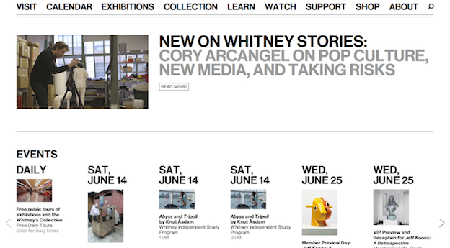
Graphic Design Principles
Hierarchy

Slide 38
Graphic Design Principles
References
Jacci Howard Bear. 2018. The Principles of Graphic Design. [ONLINE] Available at: https://www.lifewire.com/principles-of-graphic-design-1077541. [Accessed 20 December 2018].
Steven Bradley. 2015. Design Principles: Compositional, Symmetrical And Asymmetrical Balance. [ONLINE] Available at: https://www.smashingmagazine.com/2015/06/design-principles-compositional-balance-symmetry-asymmetry/. [Accessed 20 December 2018].
Gareth David. 2018. Proximity Principle Of Design. [ONLINE] Available at: https://254-online.com/proximity-principle-design/. [Accessed 20 December 2018].
WDD STAFF. 2010. THE PRINCIPLE OF PROXIMITY IN WEB DESIGN. [ONLINE] Available at: https://www.webdesignerdepot.com/2010/01/the-principle-of-proximity-in-web-design/. [Accessed 20 December 2018].
Emma Moran. 2016. Graphic Design for Beginners: Proximity. [ONLINE] Available at: https://www.emmapatricecreative.com/blog/graphic-design-for-beginners-proximity. [Accessed 20 December 2018].

Slide 39
Graphic Design Principles
References
The Paper Mill Store. 2016. Design Principles: White Space. [ONLINE] Available at: https://blog.thepapermillstore.com/design-principles-white-space/. [Accessed 20 December 2018].
The Paper Mill Store. 2015. Design Principles: Alignment. [ONLINE] Available at: https://blog.thepapermillstore.com/design-principles-alignment/. [Accessed 20 December 2018].
Creative Market. 2016. Learn Web Design: How Repetition Leads to Rhythm. [ONLINE] Available at: https://creativemarket.com/blog/learn-web-design-how-repetition-leads-to-rhythm. [Accessed 20 December 2018].
MATT BURT. 2017. A Beginner’s Guide to Achieving Web Design Consistency. [ONLINE] Available at: https://gofishdigital.com/guide-design-consistency/. [Accessed 20 December 2018].
Gautam Gupta. 2016. C.R.A.P. Design Principles to Improve Visual Appeal. [ONLINE] Available at: http://blogs.quovantis.com/crap-design-principles/. [Accessed 20 December 2018].

Slide 40
End of Presentation

